Slide 1
Graduate Medical Education (gme) in Montana:
Key Issues
Education and Local Government Interim Committee
January 14, 2016

Slide 2
The medical education “pipeline”
K-12
Residency
(GME)
3-5 years
Practicing physician
College
4 years
Medical School (UME)
4 years

Slide 3
What is graduate medical education ?
The education that occurs after 4 years of medical school
  MD or DO
Residency
  Specialty specific e.g. Family Medicine or Internal Medicine
  3-5 years
  Required for board certification

Slide 4
What does fm residency training consist of?
Continuity clinic
  Individual patient panels
Clinical rotations in multiple specialty areas
  12 to 13 blocks of 28-30 days per resident per year
  Approximately 750 per year for Montana’s current 72 residents
  Similar for 3rd and 4th year medical students
Conferences
  Multiple per week

Slide 5
why don’t we have more residencies in MT?
Development costs
Physician leadership
  Program directors and faculty
Limited resources
  Practicing physician teachers in our communities
Accreditation obstacles and complexities

Slide 6
Montana’s gme history
Montana Family Medicine Residency
  Billings
  First class matriculated 1995
  24 residents / 8 per class
Family Medicine Residency of Western Montana
  Missoula and Kalispell
  First class matriculated 2013
  30 residents / 10 per class
Billings Clinic Internal Medicine Residency
  Billings
  First class matriculated 2014
  18 residents / 6 per class (expanding to 8 w private funding)

Slide 7
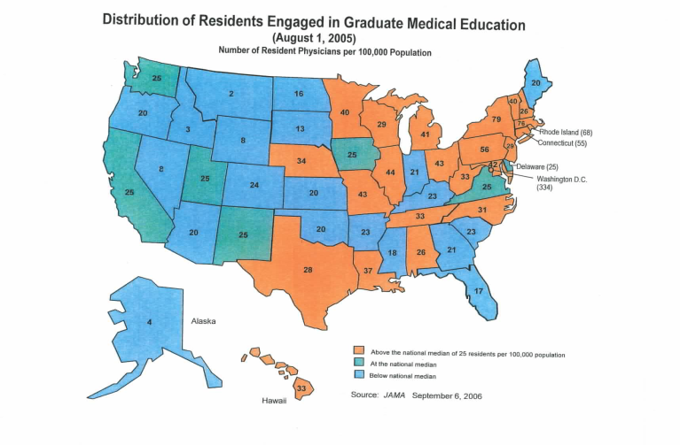
How does montana stack up in gme?
Notes:
Taken from Dr. Sarah Brotherton and Sylvia Etzel, “Graduate Medical Education, 2005-2006.” JAMA. 2006;296:1154-1169.

Slide 8
How does montana stack up in gme?
High
  New York: 79
  Massachusetts: 76
  Pennsylvania: 56
Low
  Wyoming: 7
  Alaska: 5
  Idaho: 4
  Montana: 2 (increasing to approximately 7 in 2016)

Slide 9
Why is this important?
Family Medicine February 2015
  “55% of FM graduates in U.S practice within 100 miles of their residency”
  “Reached 70% in a handful of states” (including MT!)
  “Thus, addressing the primary care shortage, particularly in underserved areas, will require an increase in the number of residency positions in those locations.”

Slide 10
2010-2012 WWAMI experience
~600 Medical students enrolled
~100 specialize in family medicine
8 join a MT residency
6 practice in MT

Slide 11

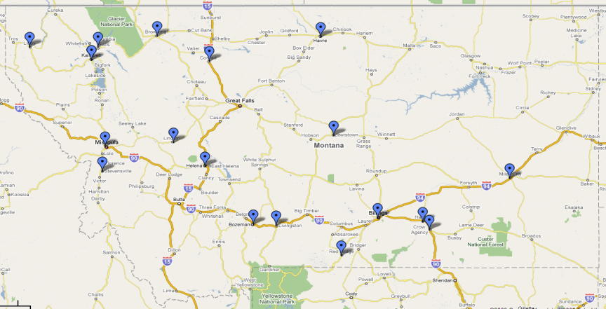
Montana FM Residency recruiting success
MFMR Residents: 105
MT Med Students: 35
WWAMI Grads: 21
Non-Montanans: 70
TOTAL = 70/105 69% Retention Rate
Notes:
Information taken from the Montana Family Medicine Residency, Billings, MT. http://www.mfmr.org/

Slide 12
The initial FMRWM experience
At least 5 and perhaps 7 of the 2016 graduating class will remain in Montana
  4 in rural communities
  1 in the CHC in Helena

Slide 13
What increases the likelihood of a resident practicing in the rural and underserved parts of Montana?
More exposure to rural medical communities
Clear understanding of the unique cultures of rural communities
Good quality and comprehensive training
Opportunities for loan repayment / forgiveness
Simply placing a larger number of physicians in MT will not solve the rural / underserved workforce issues.

Slide 14
How are MT residencies funded?
MT residency programs
Montana
state funding
Sponsoring hospitals cover budget deficits
Federal GME funding through sponsoring hospitals

Slide 15
Where does the state funding reside?
Within the MUS budget
Connected to DPHHS (state Medicaid contract)
  Allows 3:1 federal matching dollars to increase the total state funding from $519,336 to approximately $1.5M per year

Slide 16
History of hospital and State Funding of GME
Approximate amounts
Billings Clinic and St Vincent Healthcare 1996-2015 $4,500,000
Providence St. Patrick
Community Medical Center 2013-2015 $ 720,000
Kalispell Regional Medical Center
State Funding of GME $319,000-$519,000 annually

Slide 17
The economic impact of investment in gme
Family Medicine Residency – Return on Investment*
  Annual economic impact of one new FM physician $1,958,600
  Cost to educate one FM physician $ 928,500
    At a retention rate of 70%
  ROI in year 1 and every year thereafter 2.11 x
* Source: Family Medicine Residency – Return on Investment Study by Larry White

Slide 18
The Economic Return to Montana’s economy oF MFMR Graduates 1998-2015
MFMR Graduates in Montana: 70 physicians
Total years of medical practice: 537 physician-yrs
$1.98 million economic impact/physician/yr $1,063,260,000

Slide 19
What would additional MT gme funding accomplish?
Additional state funding would help to increase training in rural areas and increase the number of graduating physicians who practice there.

Slide 20
A Montana Psychiatry Training Track
University of Washington psychiatry residency regional training tracks – a successful model for Montana.
  Years 1 and 2 in Seattle, WA
  Years 3 and 4 at a regional site (Boise, ID or Spokane, WA)
Boise, ID from 2007 to Present: 63% of graduating psychiatrists remained in Idaho.
Spokane, WA from 1992 to 2014: 83% of graduating psychiatrists remained in Washington during last 5 years of the program.
  Converted to a fully independent, 4-year psychiatry residency.

Slide 21
SUMMARY: Key POINTS
Graduate Medical Education (GME) or residency is the specialty training that occurs after medical school.
Physicians are considerably more likely to practice in the vicinity of their residency than their medical school.
The creation of residency slots is a key mechanism to increase the number of primary care physicians in MT.
Residents are more likely to practice in rural and underserved areas if they train in them.
Increased state funding would enhance the ability of the current residencies to provide rural training.

Slide 22
Questions?
Thanks for listening…

